Slide 1
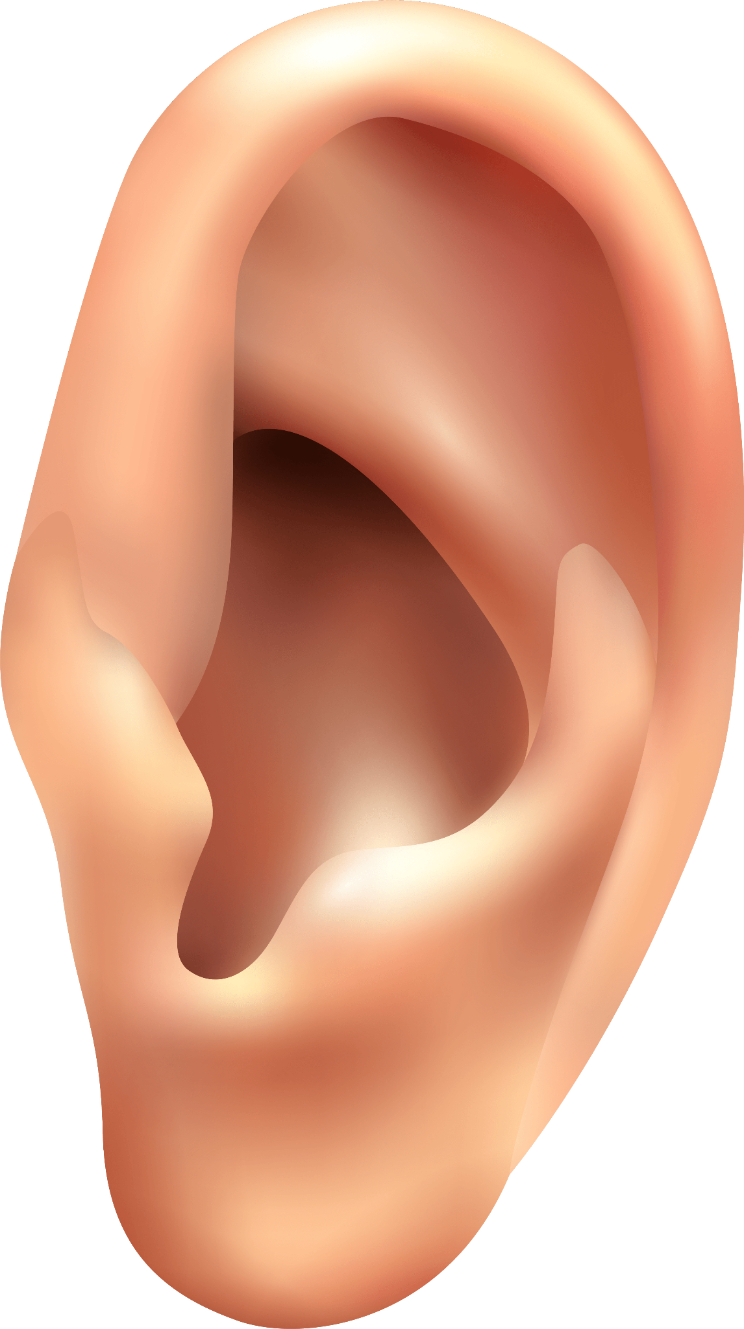
Digital Hearing Aid -Enhance the Listening experience
Hamza Ikram (2020-CE-06) [50%]
Talha Arfan (2020-CE-15) [50%]

Slide 2
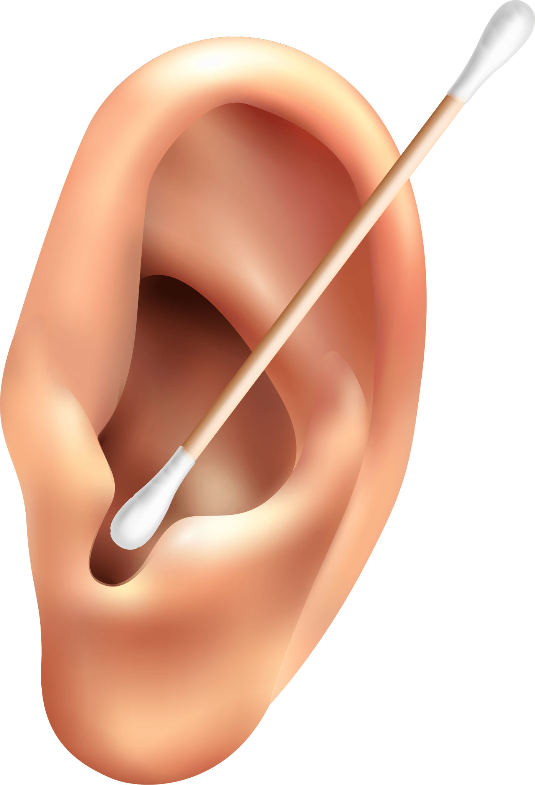
TABLE OF CONTENTS
01
02
03
04
Introduction
Objectives
Agenda
Literature Survey

Slide 3
TABLE OF CONTENTS
05
06
07
08
Methodology
Workflow Diagrams
Results and Evaluation
Technique Studied

Slide 4
TABLE OF CONTENTS
09
10
11
12
GUI and Program Flow
Sample Responses
Problem Faced
Conclusion

Slide 5
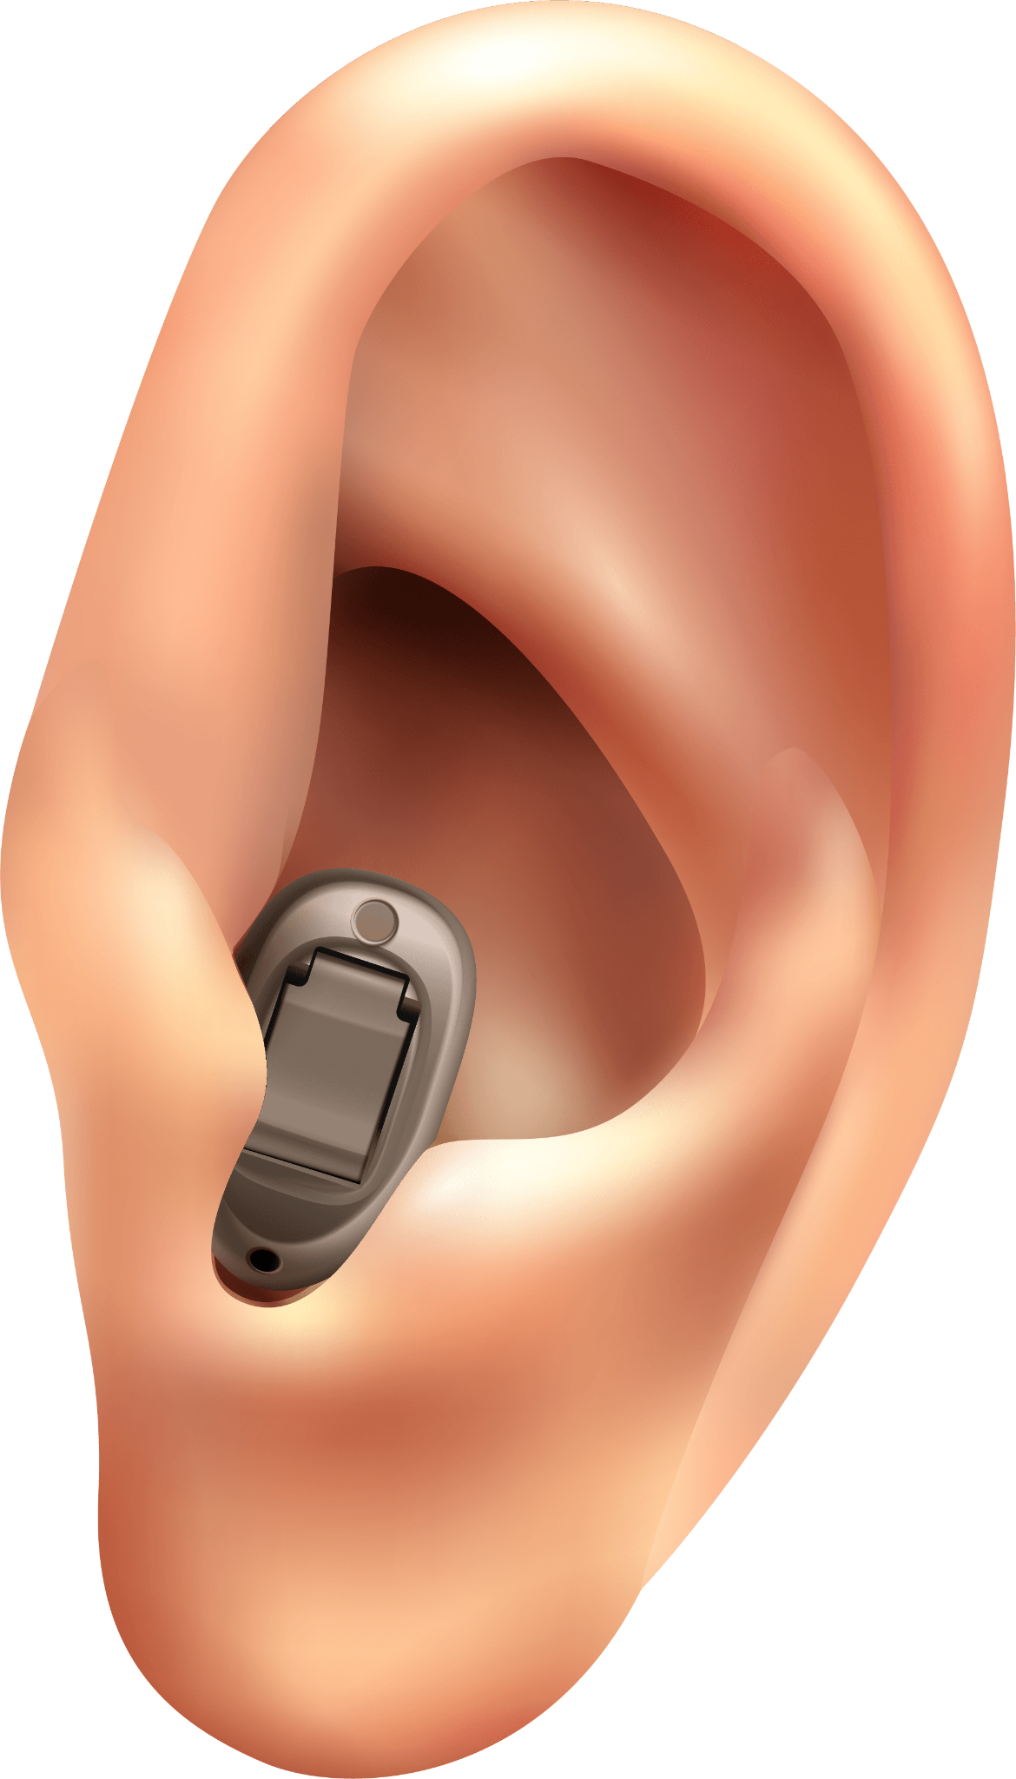
01
Introduction

Slide 6
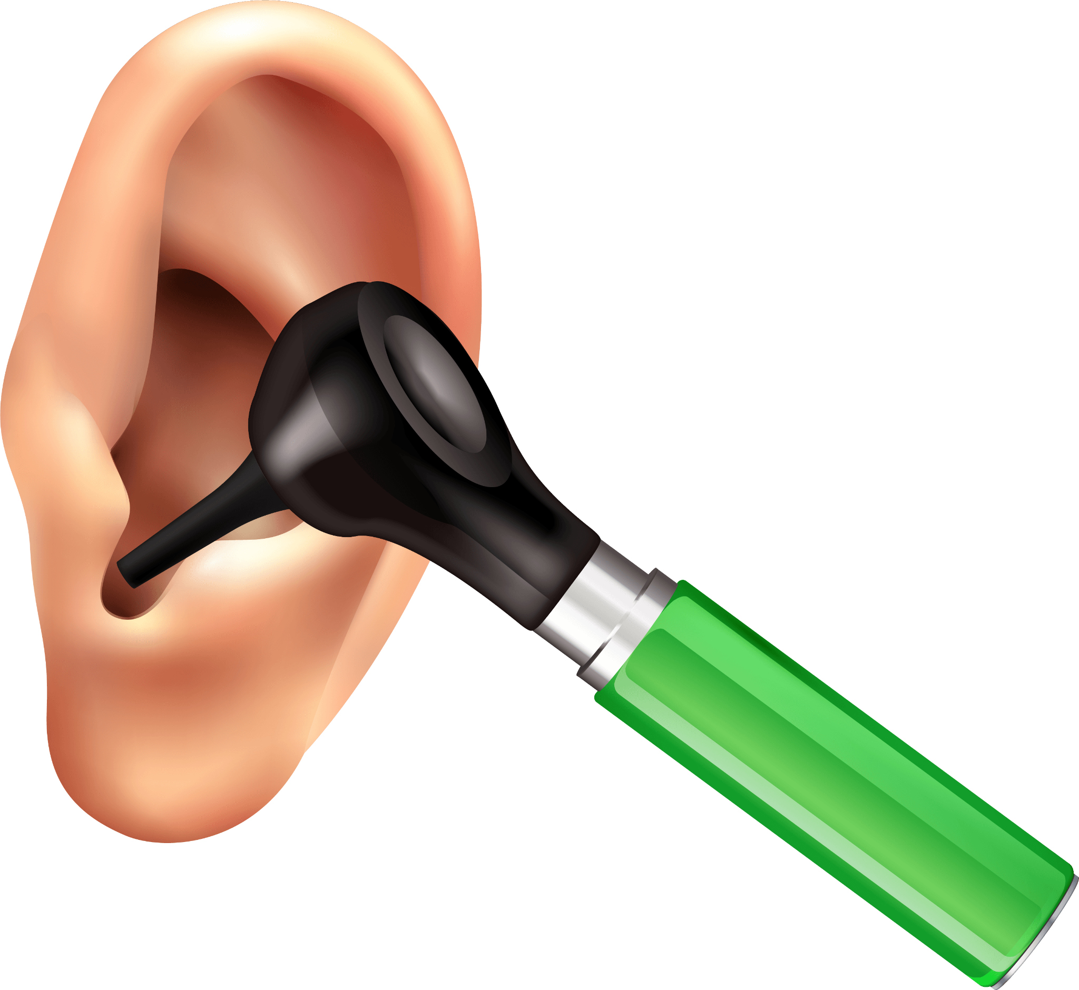
INTRODUCTION
Digital hearing aid is a sophisticated and advanced device
Improve the Quality of Sound
Improve the Quality of Life

Slide 7
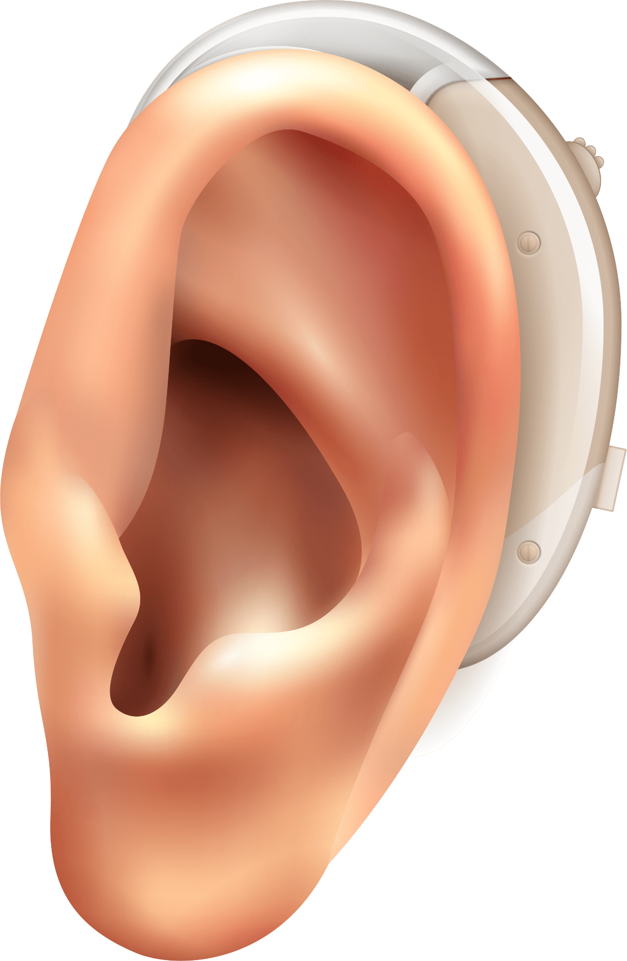
02
Objectives

Slide 8
Objectives
01
02
03
Analysis of the current Hearing Aid Market
Establish partnerships with Audiologists and Healthcare Providers
04
User-Friendly Interface
Monitor and Improve the hearing aid's performance

Slide 9
03
AGENDA

Slide 10
Agenda
Preprocessing and Noise Reduction
Speech Enhancement
Algorithms for speech enhancement
Amplification of Sound
Implement algorithms to preprocess the audio signals
Apply noise reduction techniques
User Interface
User-friendly interface using MATLAB

Slide 11
04
Literature Survey

Slide 12
Literature Survey
01
02
03
M.B.Rad and H.Kazemi Borojueni in 2016
A.R.Vasista and R.Srinivasan in 2018
G.Tames et al.
Algorithm for Noise Reduction using the discrete wavelet transform (DWT)
Enhancing speech Intelligibility
Reducing feedback
Hearing aid signal processing based on notch filter.

Slide 13
05
Methodology

Slide 14
Methodology
01
02
03
04
Understand the HAS
Simulate HAS
Understand the basic architecture of the hearing aid system.
The next step is to simulate the hearing aid system in MATLAB.
Apply DSP Algorithm
Real Time Implement
Noise Reduction
Amplification
Rrequency filtering
Wavelet Transform
Fourier Transform
The final step is to implement the DSP algorithms in a real-time system..

Slide 15
06
Workflow Diagrams

Slide 16
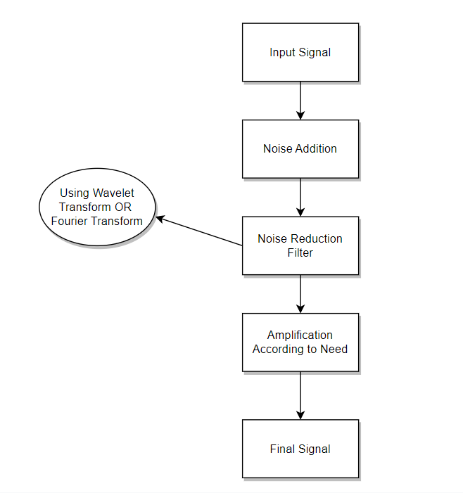
Block Diagram

Slide 17
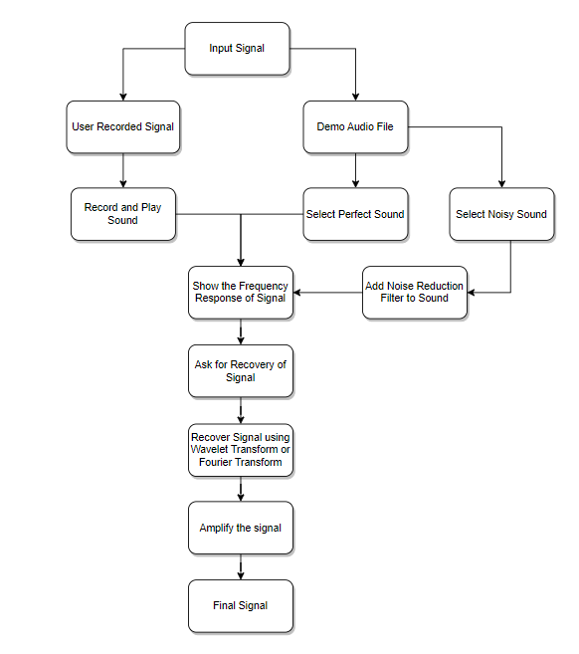
Algorithm

Slide 18
07
Results and Evaluation

Slide 19
Results and Evaluation
Objective Measures
Real-world Performance
Signal-to-Noise Ratio (SNR)
Field Trials
Long-Term User Experience
Subjective Measures
Comparison with Existing Systems
Questionnaires and Surveys
User Feedback
Compare the performance
Evaluate its effectiveness

Slide 20
08
Techniques Studied

Slide 21
DSP Algorithms and Techniques
Noise Reduction
Spectral Enhancement
Suppress background noise
Adaptive Filtering
Modify the Spectral Characteristics of the input signal
Frequency Compression
Feedback Cancellation
Dynamic Range Compression (DRC)
Eliminate the annoying feedback
Notch Filters
Compress range of sounds Comfortable for the user
Amplifies soft Sounds to prevent discomfort

Slide 22
09
GUI and Program Flow

Slide 23
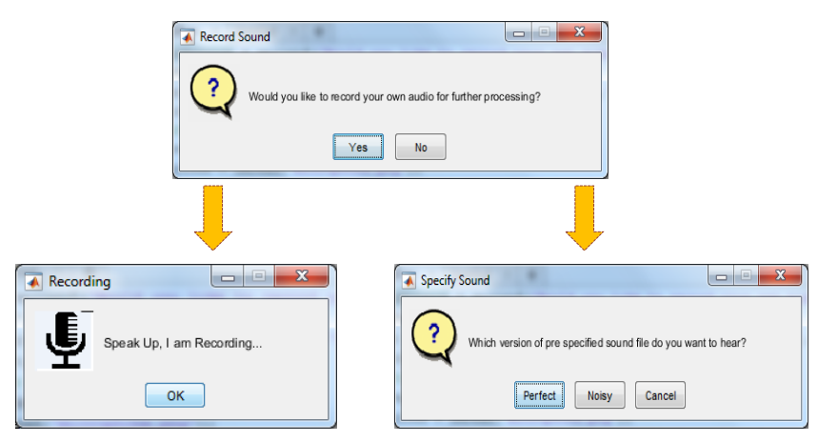

Slide 24
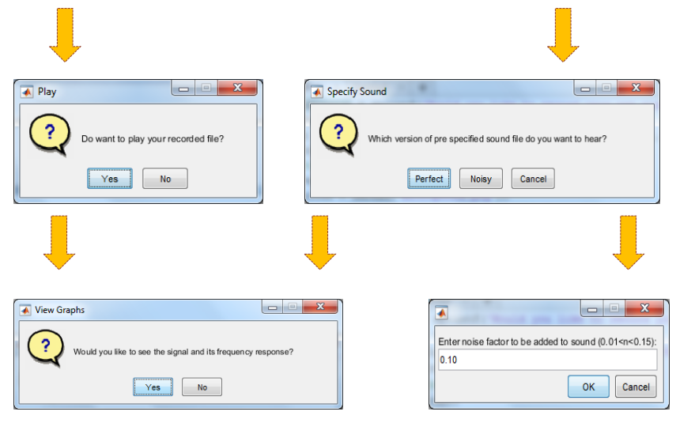

Slide 25
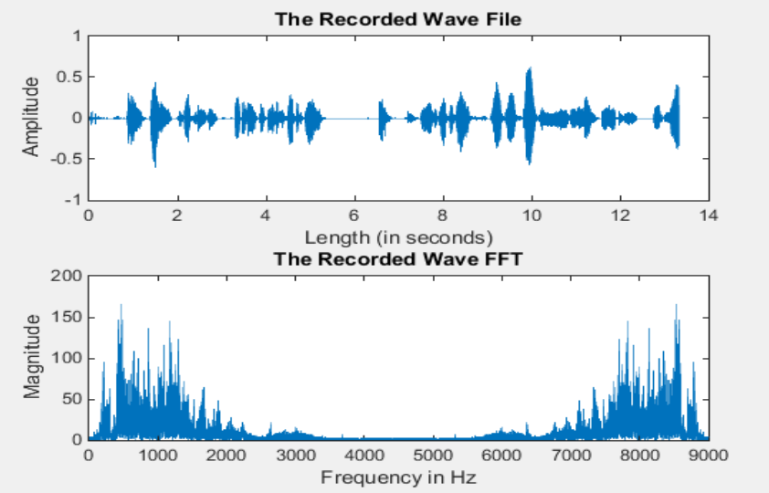
The Spectrum of Audio Recorded

Slide 26
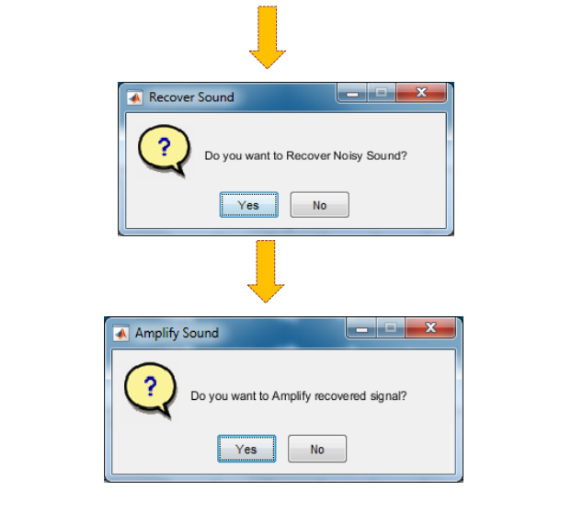

Slide 27
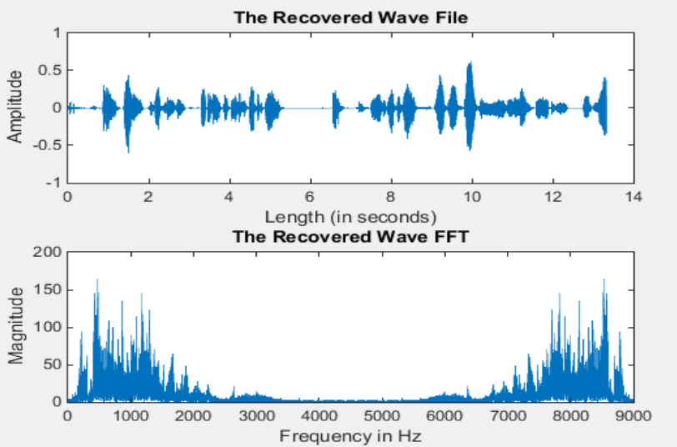
Recovering Signal i.e., Removing Noise

Slide 28
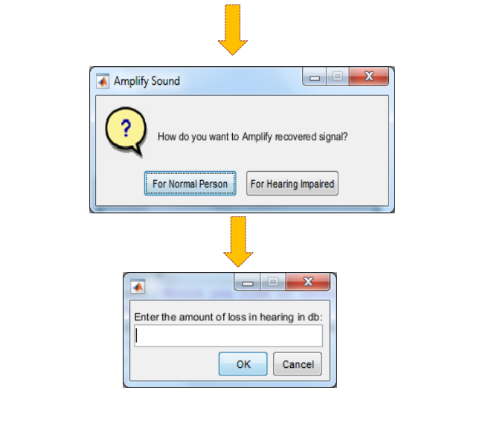

Slide 29
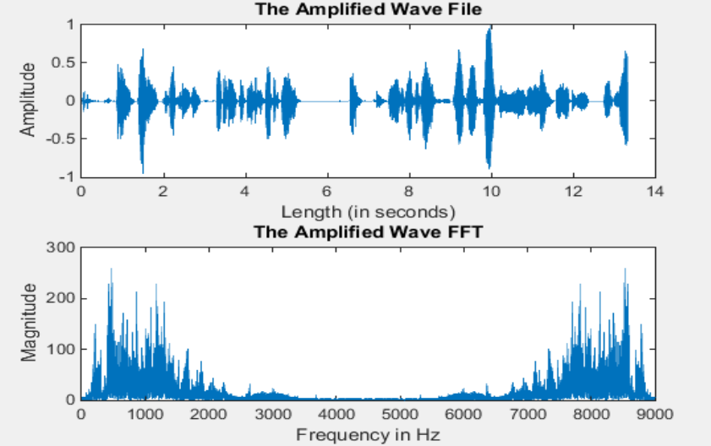
Amplification of Recovered Audio
Amplification of Recovered Audio

Slide 30
10
Sample Responses

Slide 31
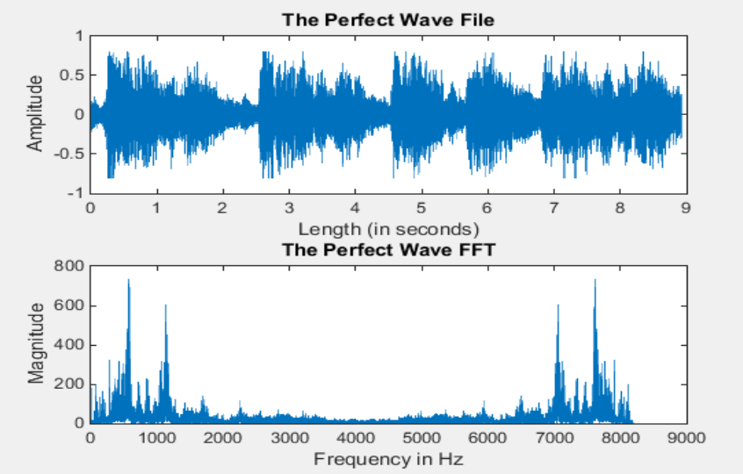
The Perfect Sound

Slide 32
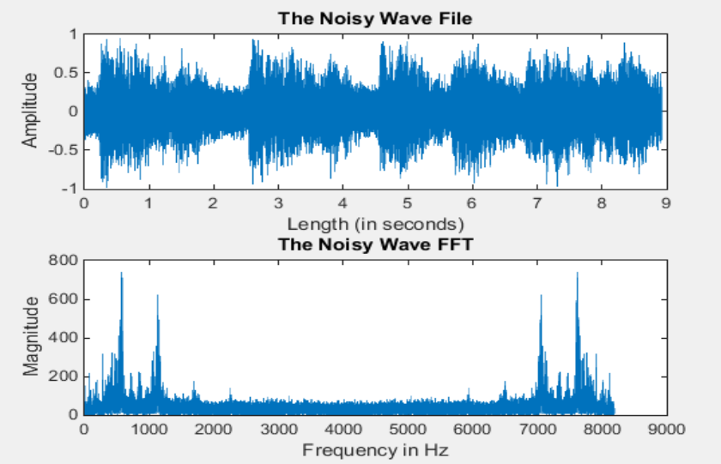
Addition of Noise in Signal

Slide 33
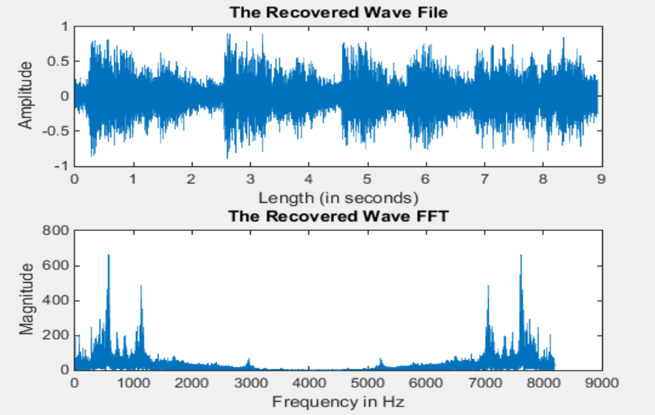
Recovery Using Wavelet Transform

Slide 34
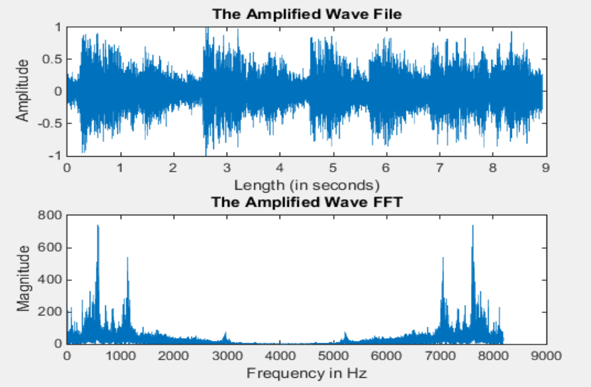
For Normal Hearing

Slide 35
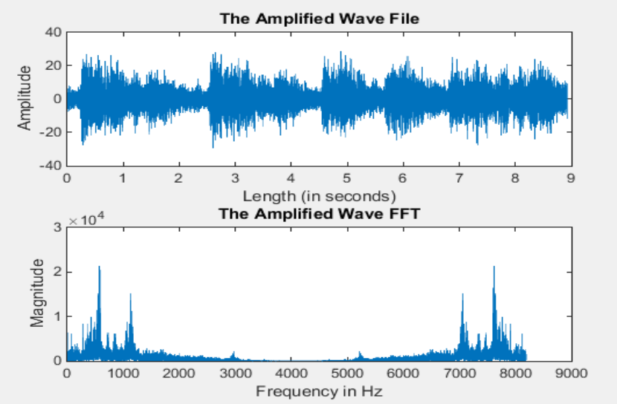
For Hearing Loss of 30dB

Slide 36
11
Challenges Faced

Slide 37
Challenges Faced
A
B
C
D
Signal Processing Issues
Accuracy
Hearing aid must amplify the correct signals
Slight error | Inadequate Amplification
Environmental Noise
Intuitive user interface
Work Effectively in Noisy environments
Intuitive
Easy to Use

Slide 38
12
Conclusion

